Slide 1

AutoCart
ENGR 697 Final Presentation
Personal Automated Transport Equipment
Miguel Yamamoto - CompE
Ricardo Colin - CompE
Anna Maka - CompE
San Francisco State University

Slide 2

Outline
Introduction
Main Purpose
Approach and Design (Original and 2nd)
Obstacles/Remodel
Approach and Design (Final)
Video Examples
BOM/Cost
Conclusion
Q/A

Slide 3
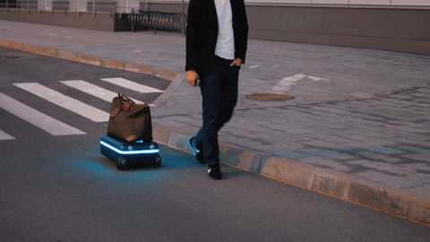
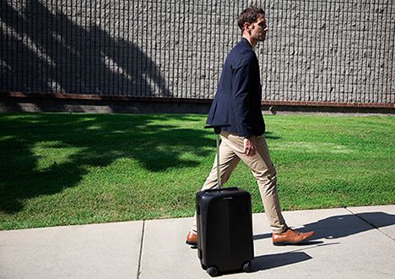
Introduction
AutoCart is a type of transport for equipment, groceries, and other items that would be otherwise too heavy for individuals to carry
There has been projects that has a similar idea such as OVIS a luggage that follows the traveler around, this is a rather expensive and space limited item.
Ex. OVIS suitcase by FowardX
Rideable Smart Luggage
(Naucrates)

Slide 4

Main Purpose
While observing many people in parks, shopping mall, groceries, and even kids carrying bags that are too heavy for them
This will help to:
Reduce back pains
Reduce spine issues
Help people who can’t carry heavy items
Help elderly

Slide 5
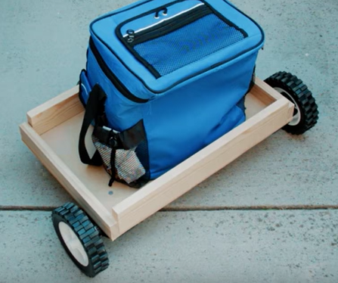
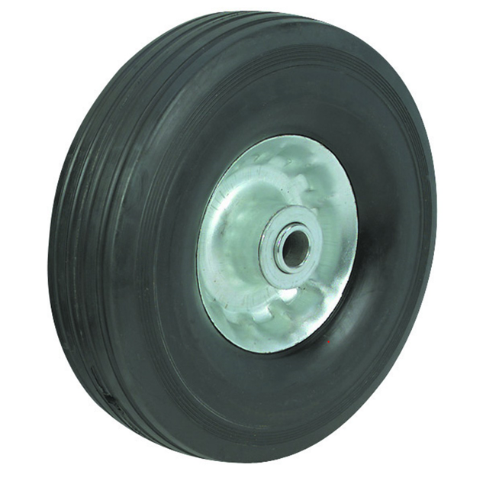
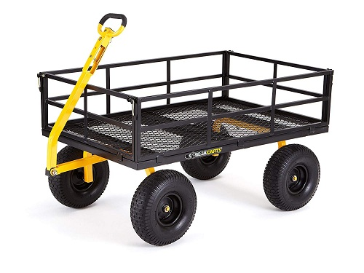
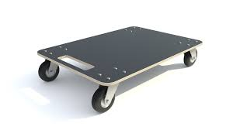
Original Approach and Design
Original Design
What it would have been:
Using DC motors
Bluetooth connectivity
Heavy wheel (8” solid rubber tire steel hub)
Less battery charge (2200mAh)
Load Cell
LCD interaction

Slide 6
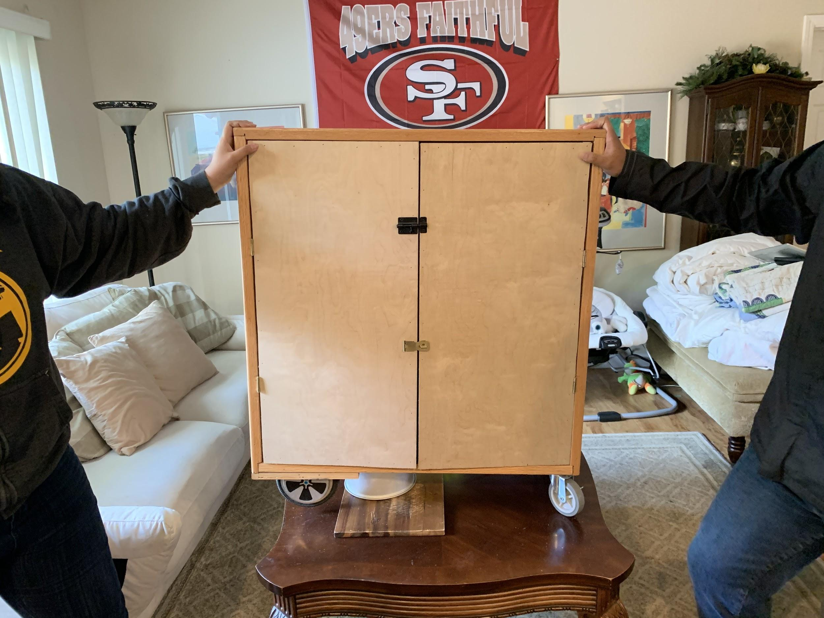
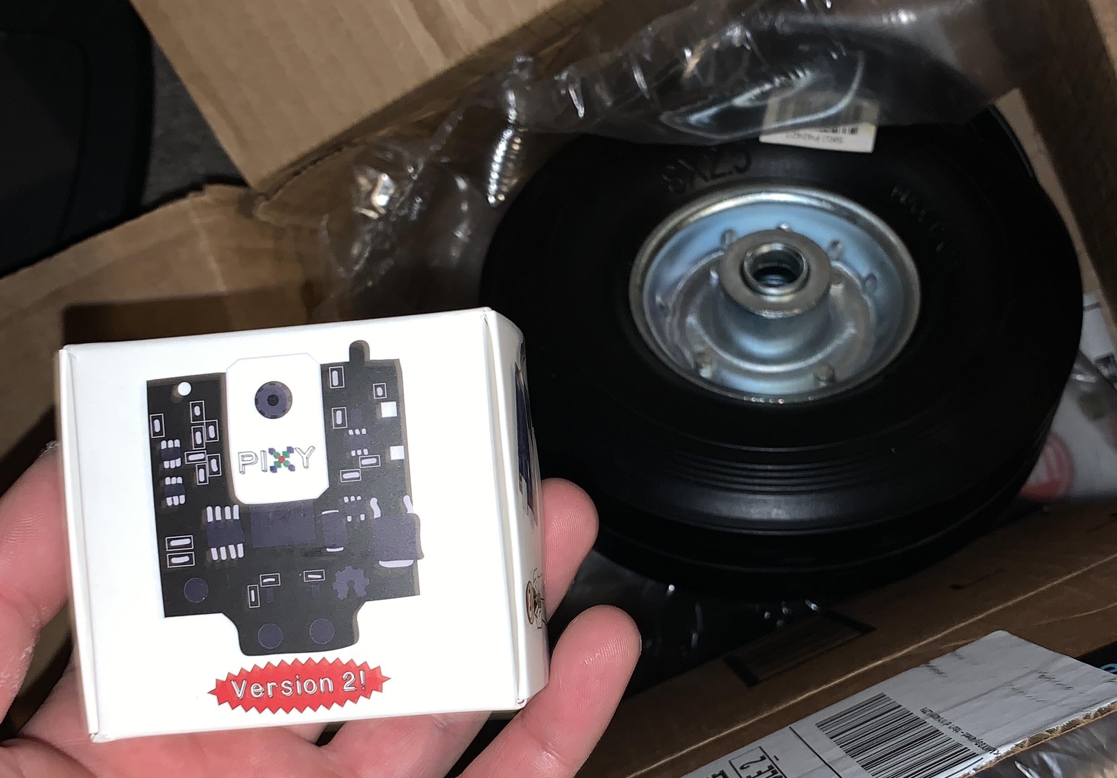
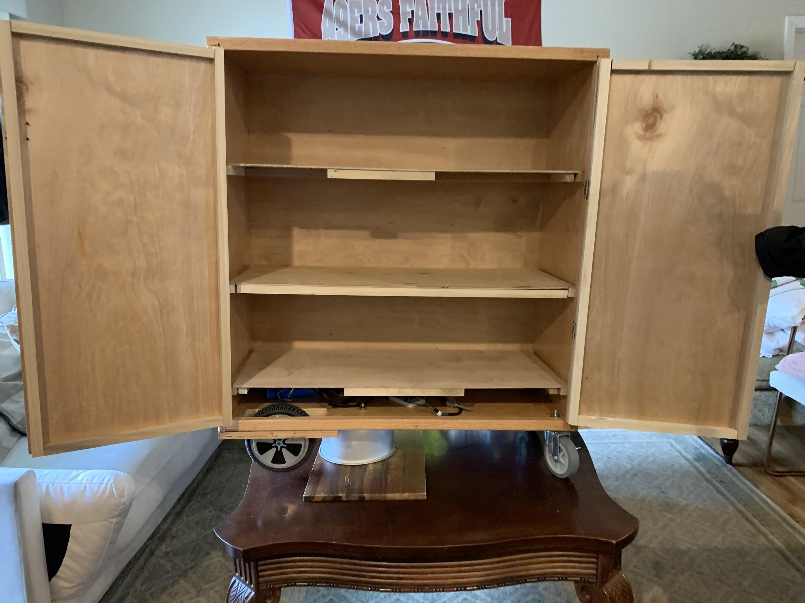
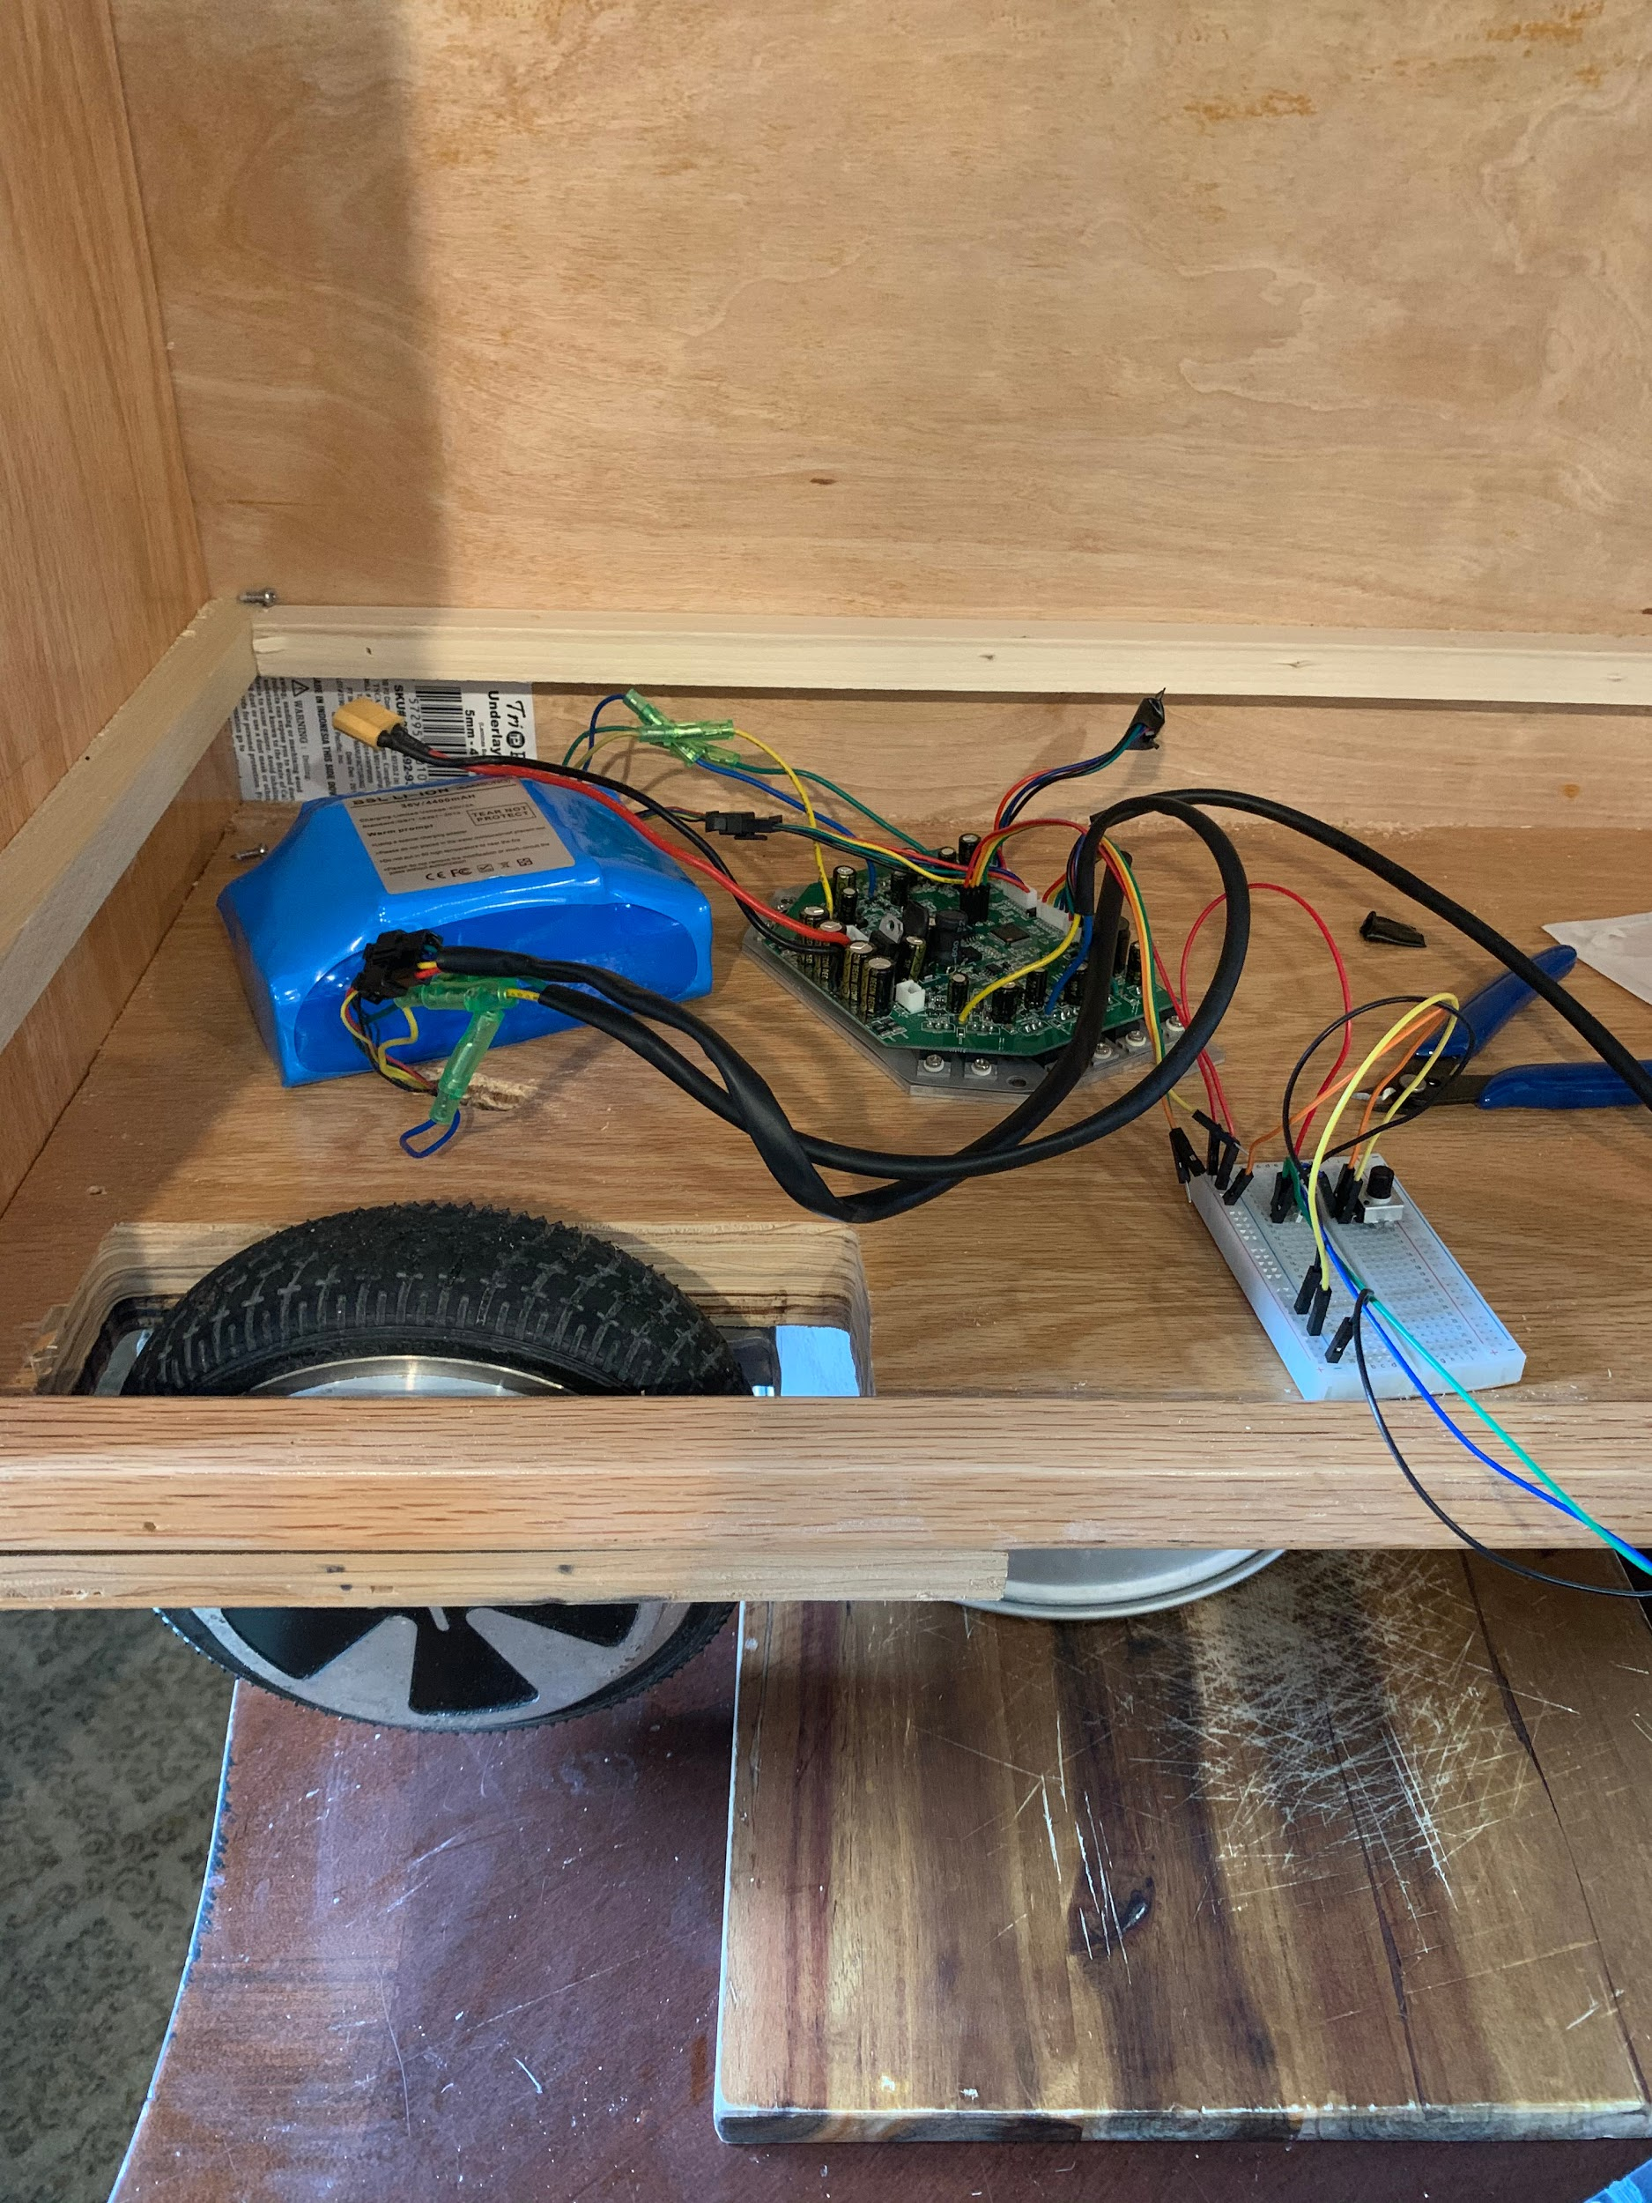
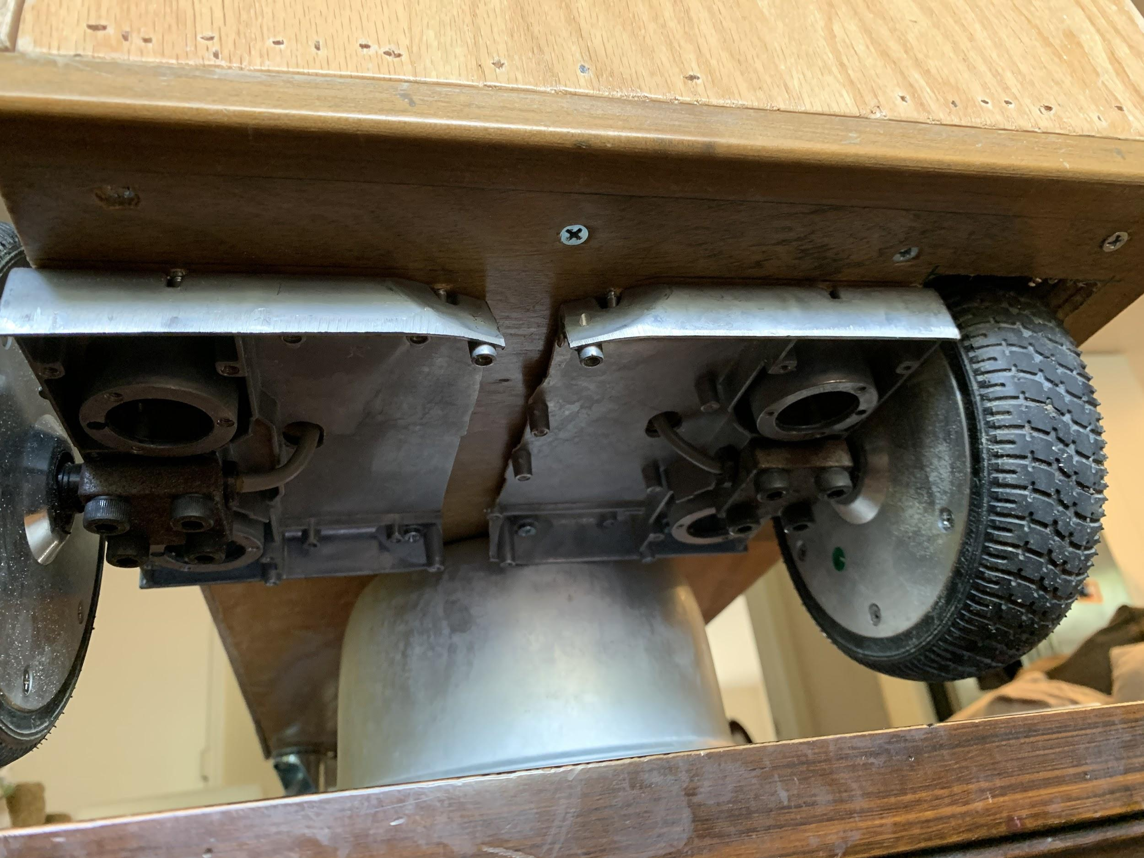
Second Approach and Design
Autoshelf???
Lock
Pixy2
Removable shelf
Doors
Rechargeable battery
Hoverboard motors

Slide 7
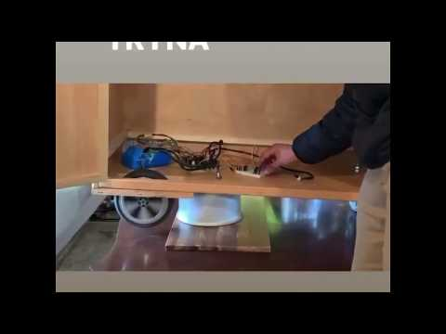
Testing motors video
https://youtu.be/fXQeiHopq1k

Slide 8
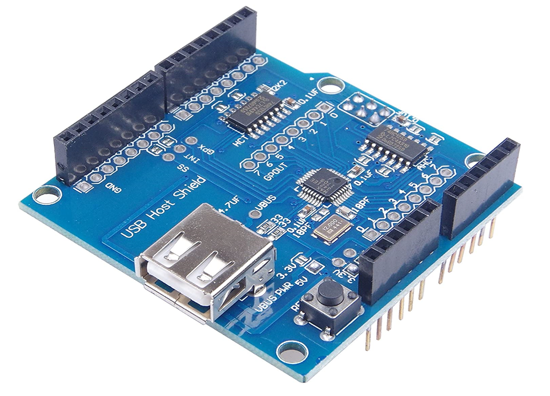
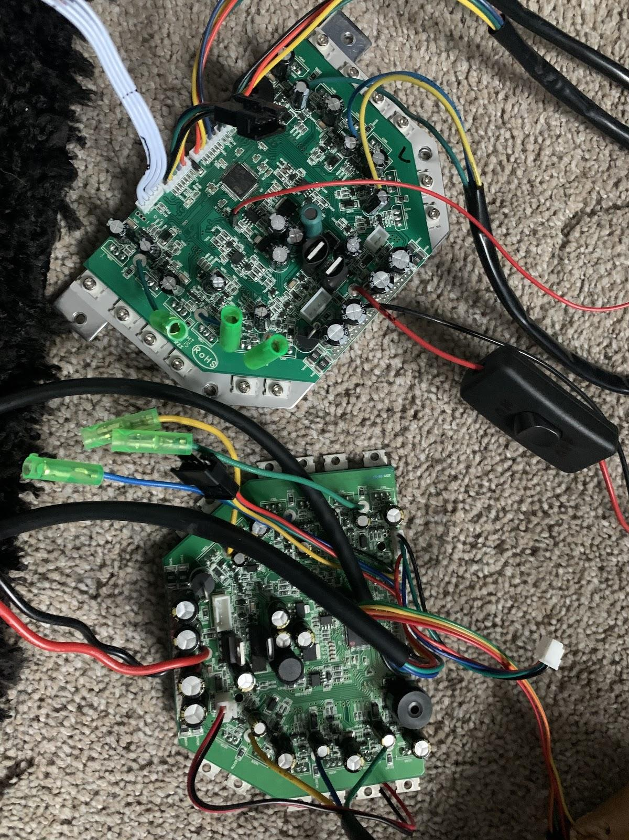
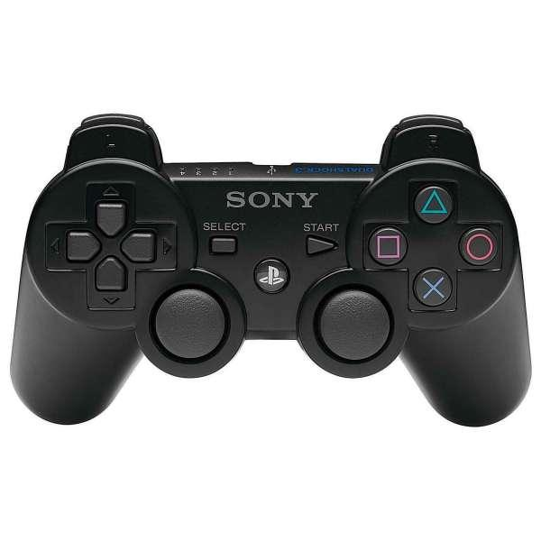
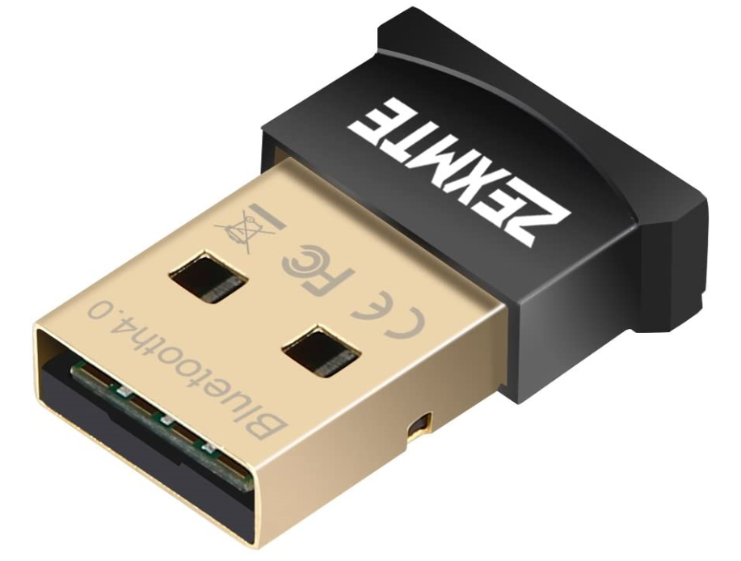
Obstacles/Remodel
Hoverboard problems
Motherboard getting fried
Added a switch for the battery
COVID-19
Parts arriving later than expected
PIXY2 color detection had difficulties in outside environment
Too many color inputs were detected
Remote Control
Use the PS3 controller
Bluetooth Adapter
Arduino Shield

Slide 9
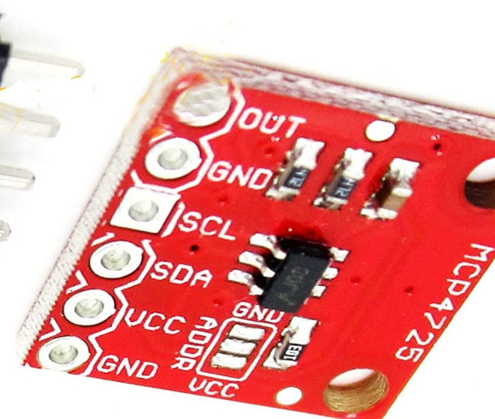
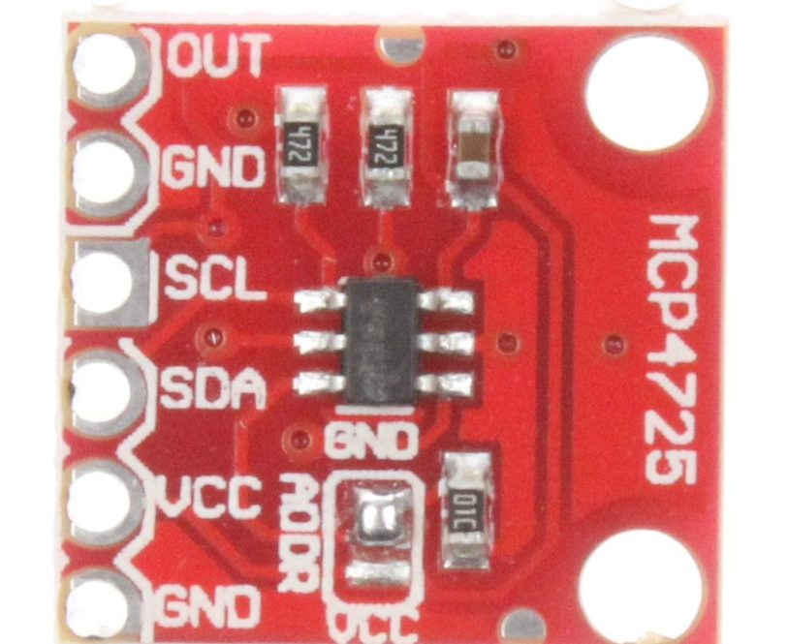
Obstacles/Remodel
DAC issues
Original DAC we bought had 3 pins
Second order of DACs came soldered GND and ADDR pin together
Our project needed one unsoldered and one soldered (ADDR and VCC) to change the port number while writing the arduino code
original pin DAC
soldered pin DAC

Slide 10
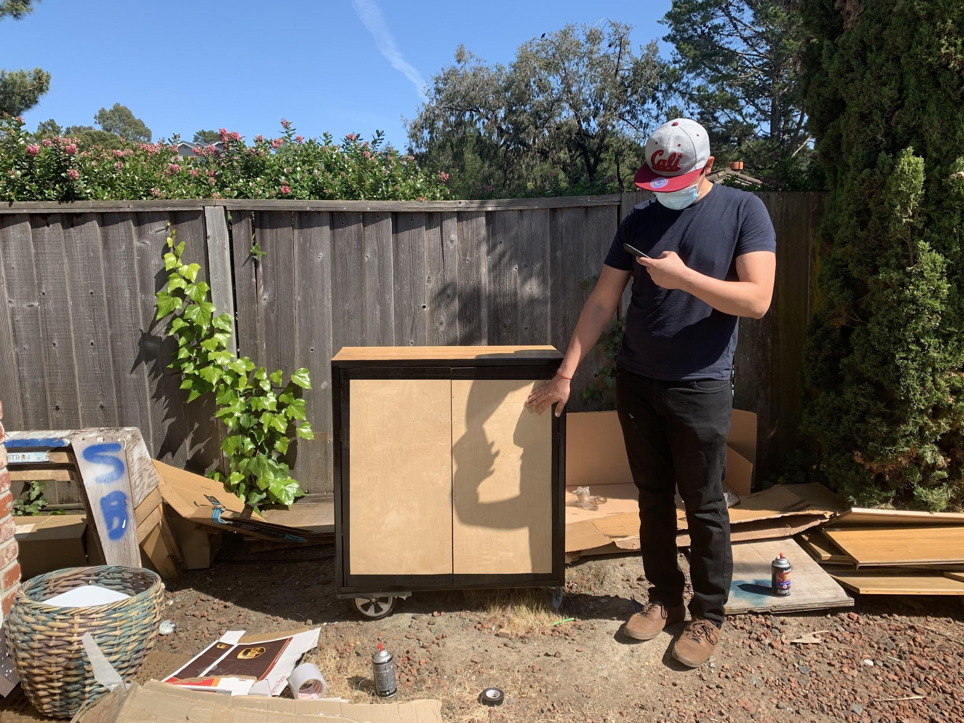
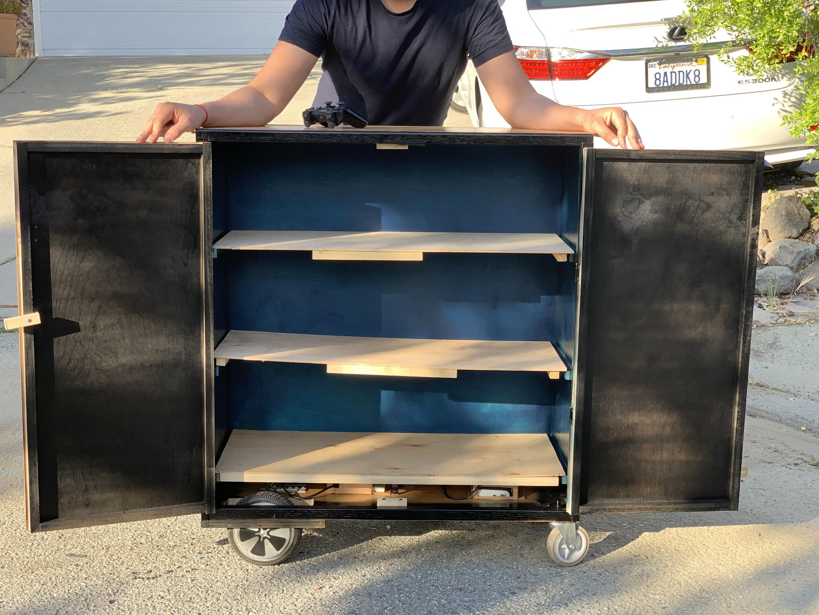
Final Design
Features
Removable shelf
Two Doors
Locks to prevent doors from opening
Rechargeable battery for motors and arduino
Amazing look that catches everyone's attention
A friend that can help
Changes
Still same concept of personal cart, unfortunately not autonomous
No longer controlled using PIXY camera
Uses a PS3 gaming controller to operate
Note: PS3 controller range is 25-30 feet

Slide 11
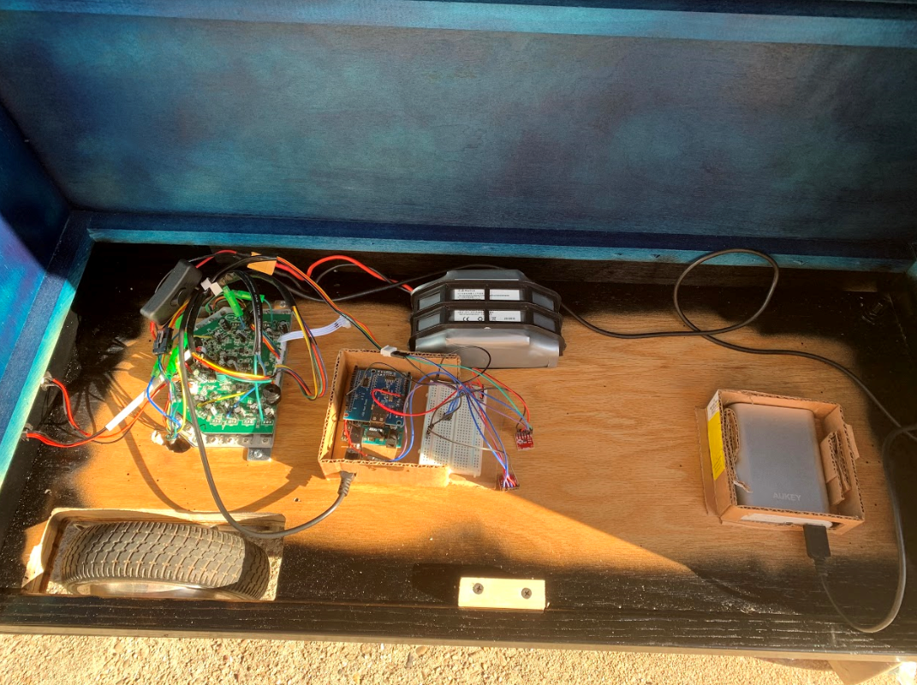
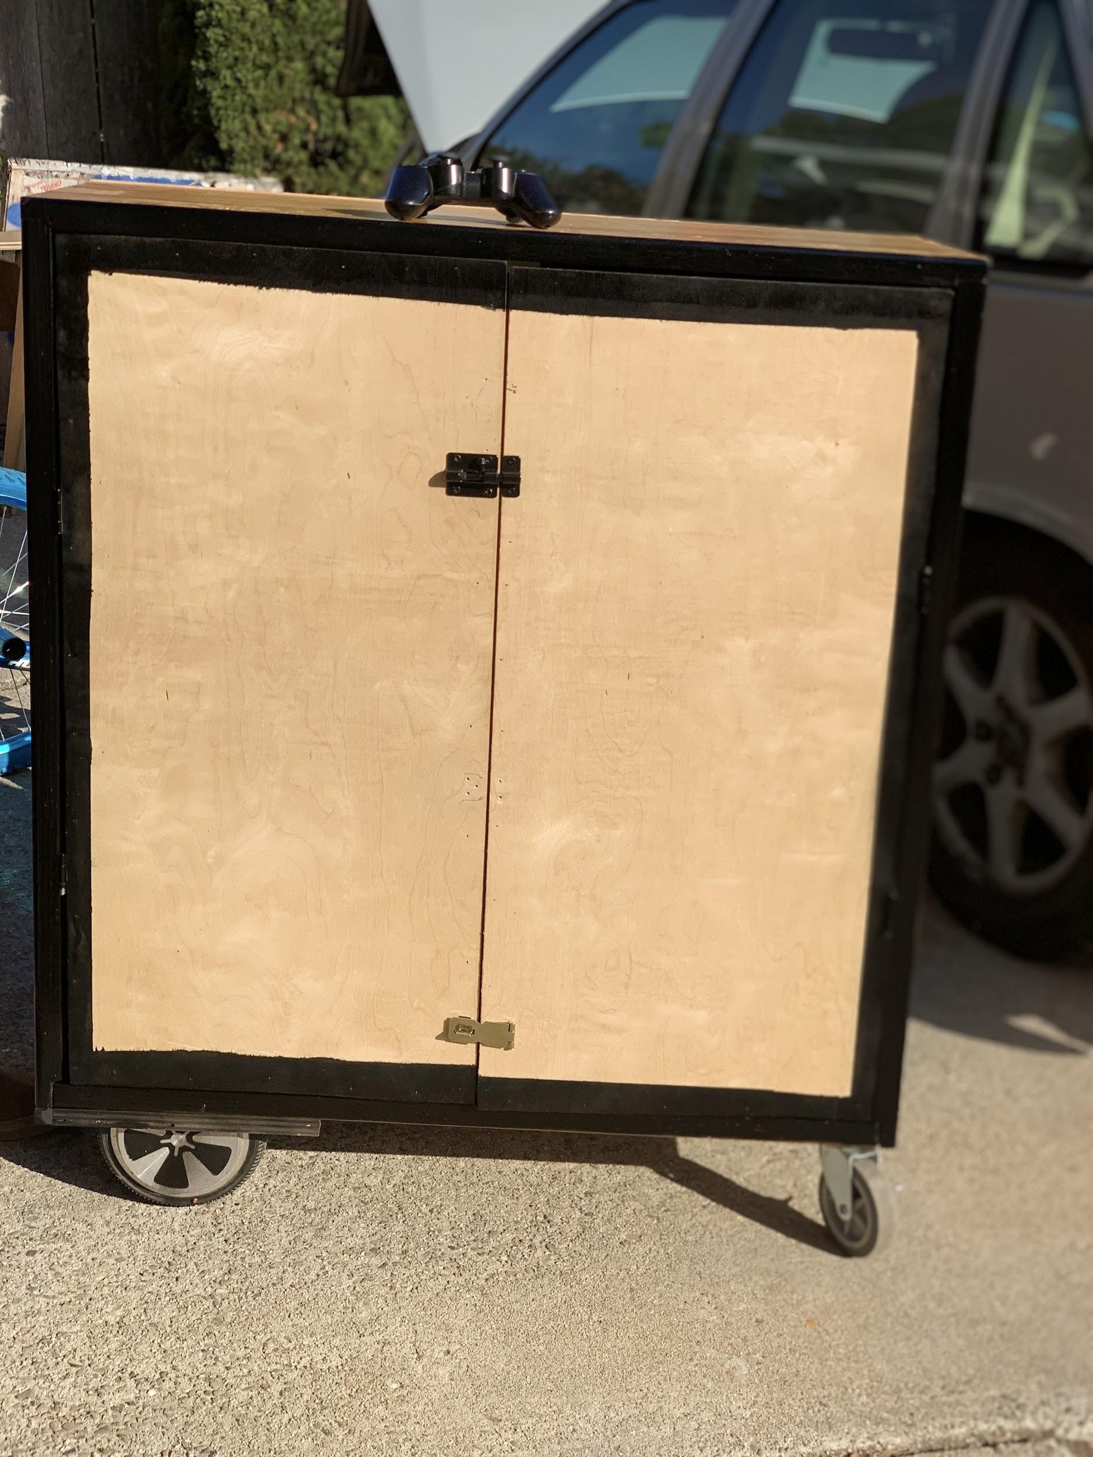
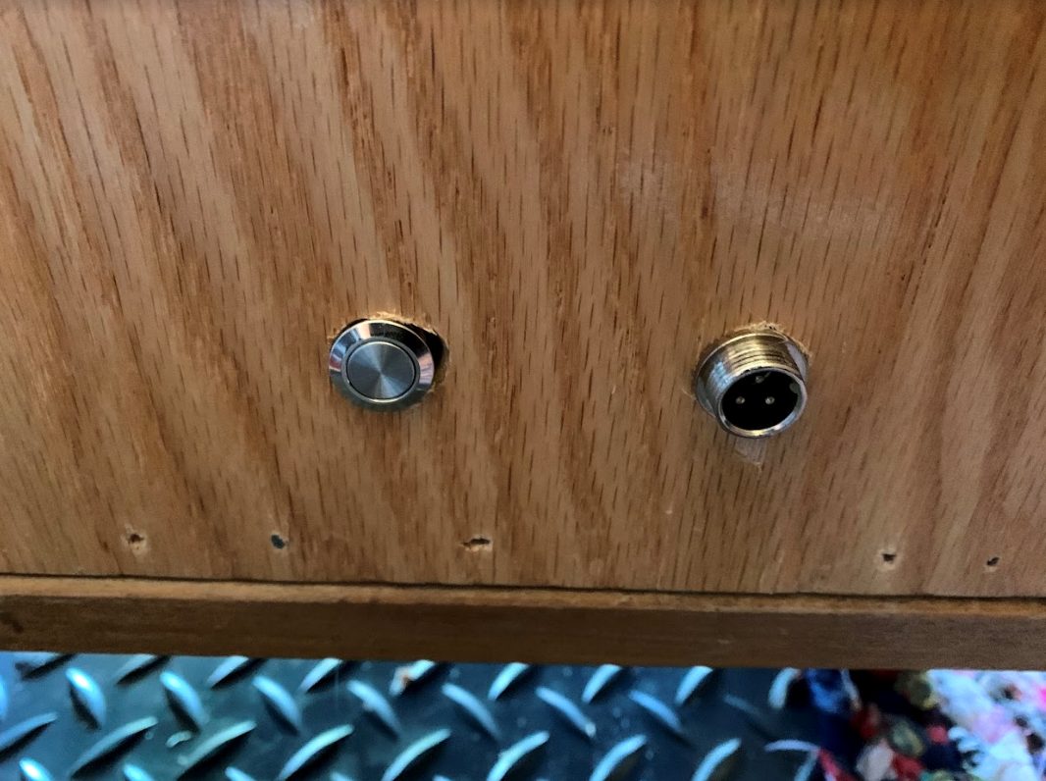
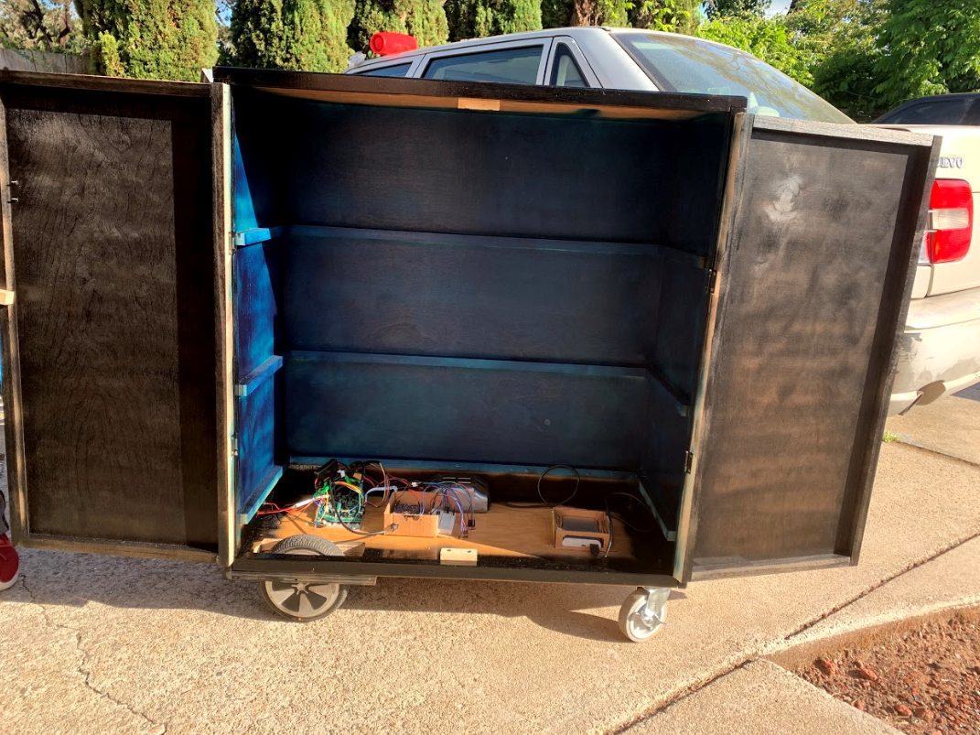
Final Design
Motors Battery
Hoverboard Motherboard
Arduino’s Battery
PS3 Controller
Arduino, Shield, Breadboard
DACs
Power On Button
Charging Port

Slide 12

How the cart works

Slide 13
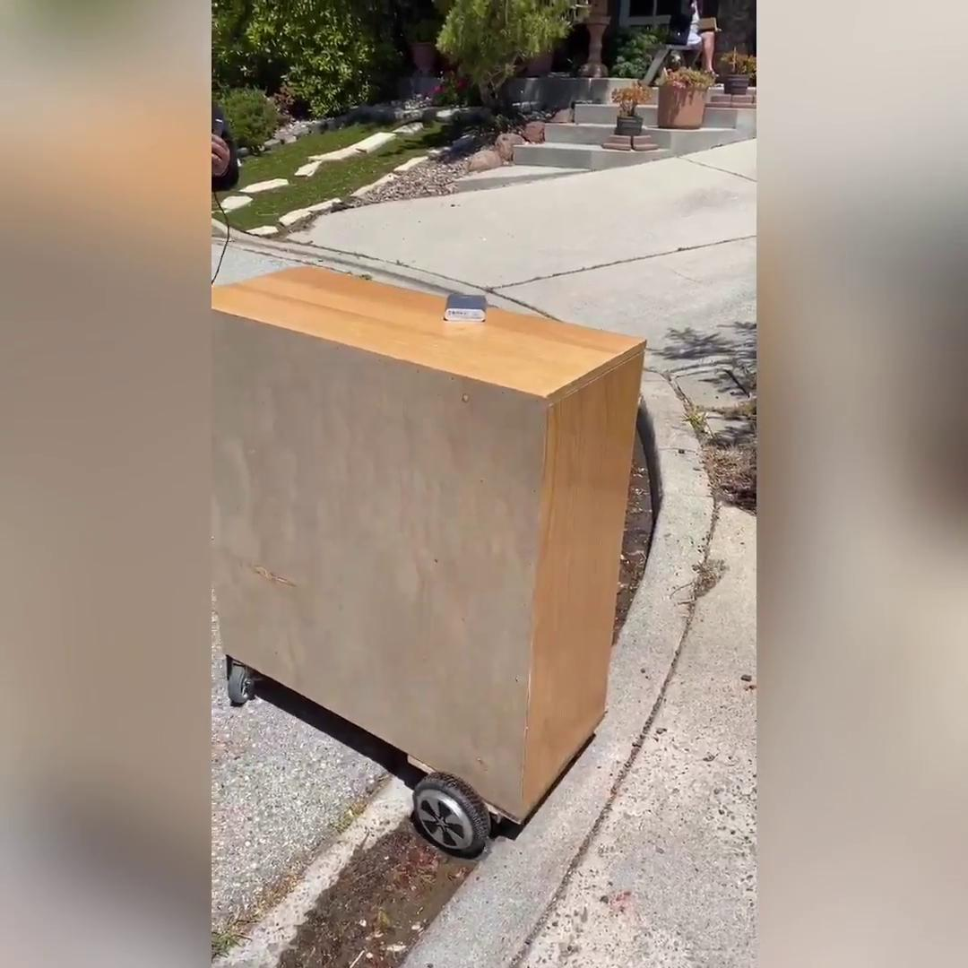
Demo 1
First demo, lower speed range

Slide 14
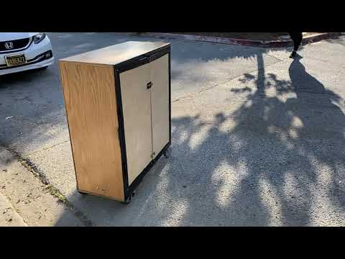
Demo 2

Slide 15
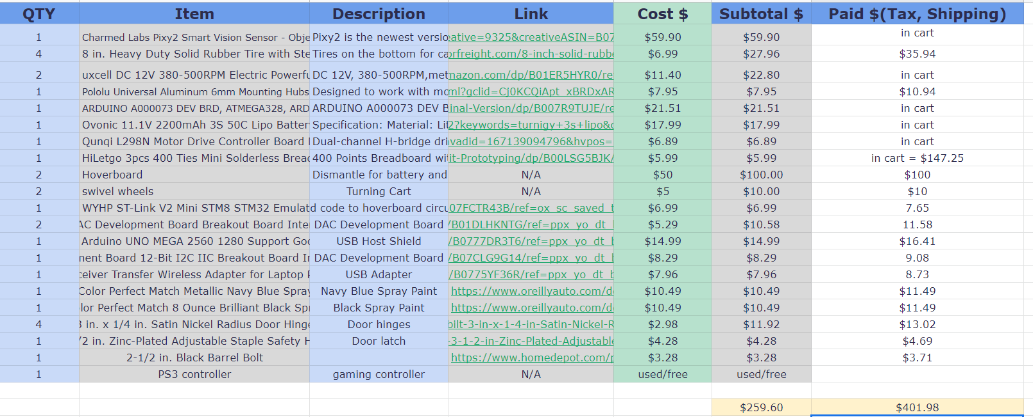
BOM/Cost

Slide 16

Conclusion
Remodel of the original concept
Using PS3, shield, and BT adapter
Improvements
Use a different camera
Paint the whole cart
Add LCD
Switch for remote control and camera
Better control speed
Add modification to the back tires

Slide 17

Questions?

